Slide 1
Distributed and Cloud Computing K. Hwang, G. Fox and J. Dongarra Chapter 3: Virtual Machines and Virtualization of Clusters and datacenters Adapted from Kai Hwang University of Southern California March 30, 2012

Slide 2
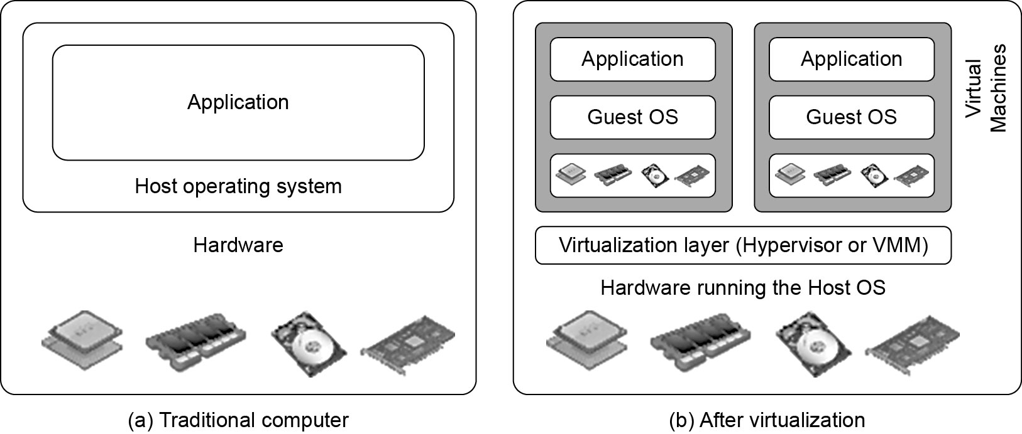
Difference between Traditional Computer and Virtual machines
(Courtesy of VMWare, 2008)

Slide 3
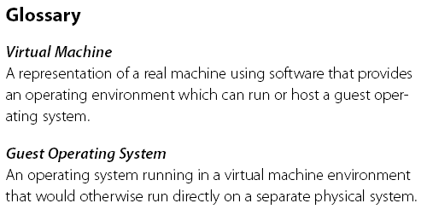
Virtual Machine, Guest Operating System, and VMM (Virtual Machine Monitor) :
The Virtualization layer is the middleware between the underlying hardware and virtual machines represented in the system, also known as virtual machine monitor (VMM) or hypervisor.

Slide 4
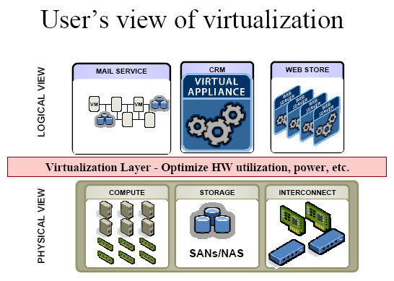
(Courtesy of VMWare, 2008)

Slide 5
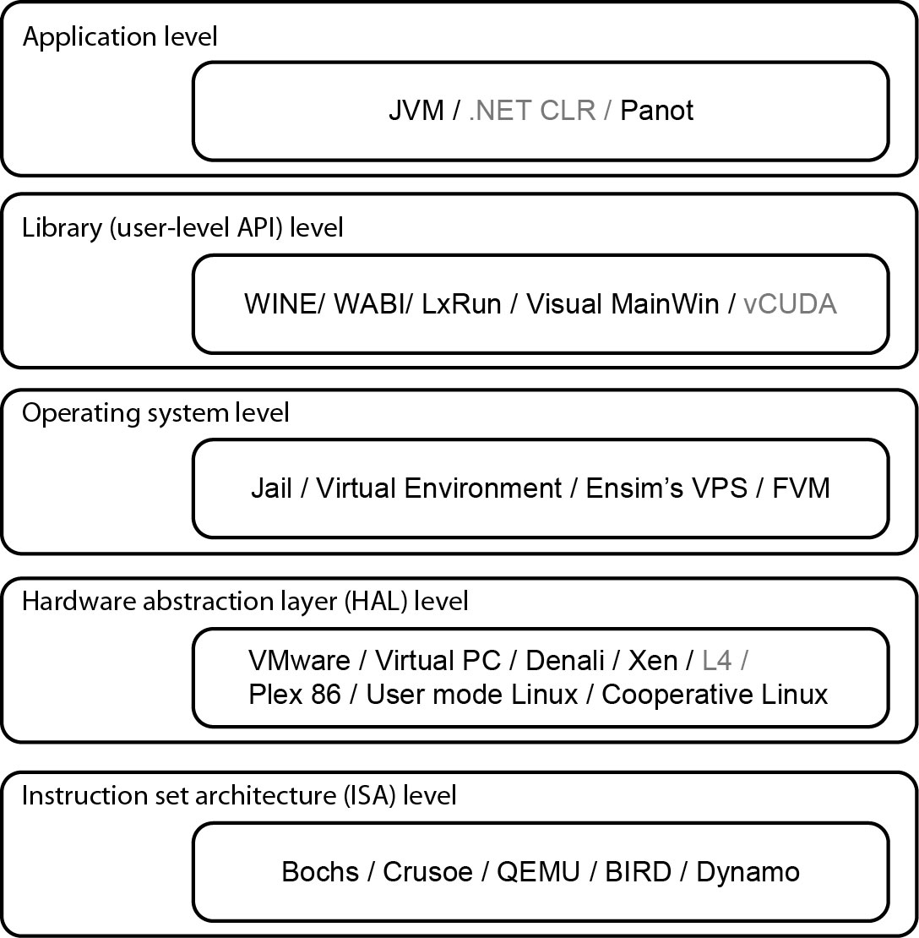
Virtualization Ranging from Hardware to Applications in Five Abstraction Levels

Slide 6
Virtualization at ISA (Instruction Set Architecture) level:
Emulating a given ISA by the ISA of the host machine.
e.g, MIPS binary code can run on an x-86-based host machine with the help of ISA emulation.
Typical systems: Bochs, Crusoe, Quemu, BIRD, Dynamo
Advantage:
It can run a large amount of legacy binary codes written for various processors on any given new hardware host machines
best application flexibility
Shortcoming & limitation:
One source instruction may require tens or hundreds of native target instructions to perform its function, which is relatively slow.
V-ISA requires adding a processor-specific software translation layer in the complier.

Slide 7
Virtualization at Hardware Abstraction level: Virtualization is performed right on top of the hardware.
It generates virtual hardware environments for VMs, and manages the underlying hardware through virtualization.
Typical systems: VMware, Virtual PC, Denali, Xen
Advantage:
Has higher performance and good application isolation
Shortcoming & limitation:
Very expensive to implement (complexity)

Slide 8
Virtualization at Operating System (OS) level:
It is an abstraction layer between traditional OS and user placations.
This virtualization creates isolated containers on a single physical server and the OS-instance to utilize the hardware and software in datacenters.
Typical systems: Jail / Virtual Environment / Ensim's VPS / FVM
Advantage:
Has minimal starup/shutdown cost, low resource requirement, and high scalability; synchronize VM and host state changes.
Shortcoming & limitation:
All VMs at the operating system level must have the same kind of guest OS
Poor application flexibility and isolation.

Slide 9
Virtualization at OS Level

Slide 10
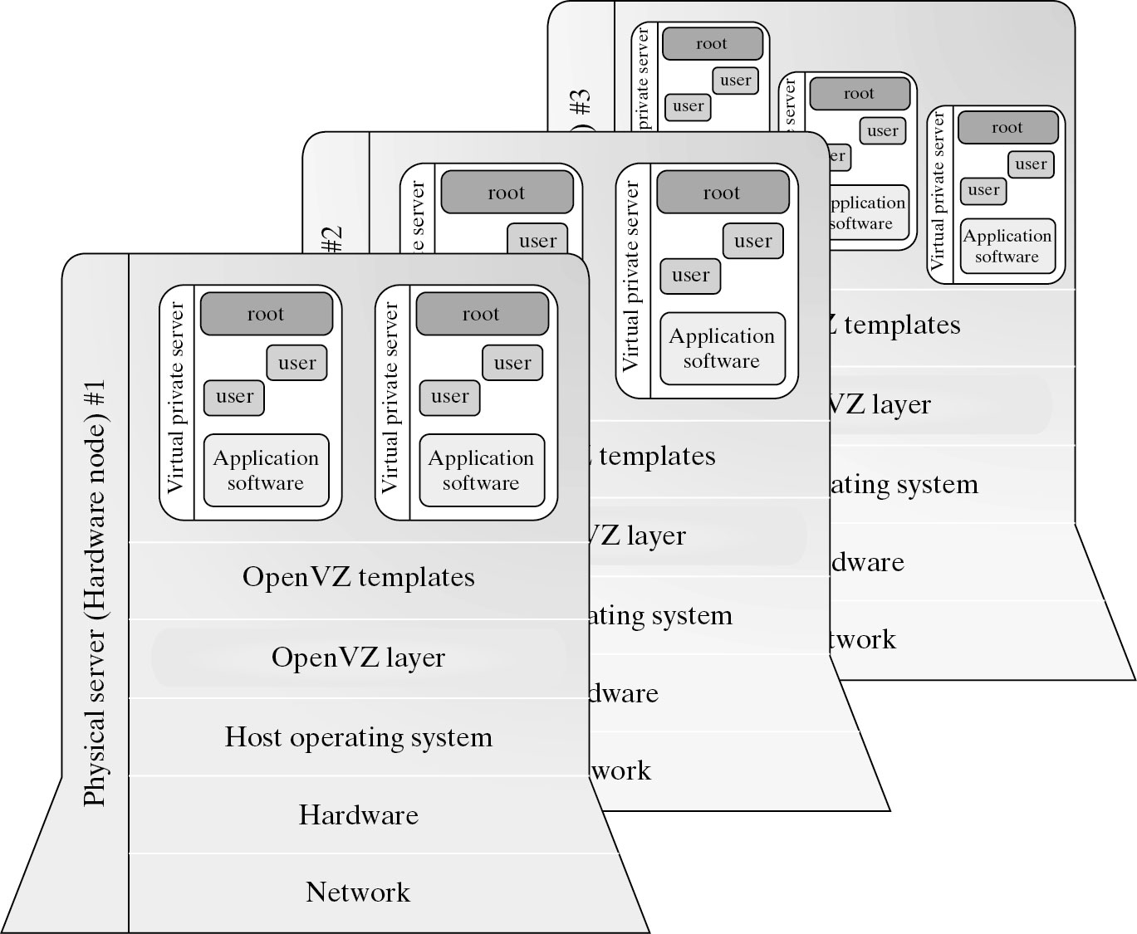
Virtualization for Linux and Windows NT Platforms

Slide 11


Slide 12
Advantages of OS Extension for Virtualization
VMs at OS level has minimum startup/shutdown costs
OS-level VM can easily synchronize with its environment
Disadvantage of OS Extension for Virtualization All VMs in the same OS container must have the same or similar guest OS, which restrict application flexibility of different VMs on the same physical machine.

Slide 13
Library Support level:
It creates execution environments for running alien programs on a platform rather than creating VM to run the entire operating system.
It is done by API call interception and remapping.
Typical systems: Wine, WABI, LxRun , VisualMainWin
Advantage:
It has very low implementation effort
Shortcoming & limitation:
poor application flexibility and isolation

Slide 14
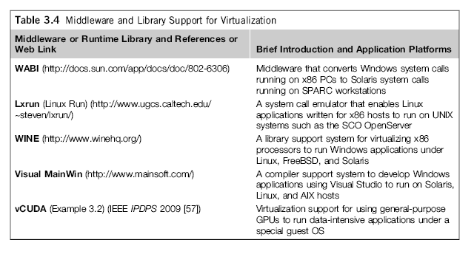
Virtualization with Middleware/Library Support

Slide 15
The vCUBE for Virtualization of GPGPU

Slide 16
User-Application level:
It virtualizes an application as a virtual machine.
This layer sits as an application program on top of an operating system and exports an abstraction of a VM that can run programs written and compiled to a particular abstract machine definition.
Typical systems: JVM , NET CLI , Panot
Advantage:
has the best application isolation
Shortcoming & limitation:
low performance, low application flexibility and high implementation complexity.

Slide 17
More Xs mean higher merit

Slide 18
Hypervisor
A hypervisor is a hardware virtualization technique allowing multiple operating systems, called guests to run on a host machine. This is also called the Virtual Machine Monitor (VMM).
Type 1: bare metal hypervisor
sits on the bare metal computer hardware like the CPU, memory, etc.
All guest operating systems are a layer above the hypervisor.
The original CP/CMS hypervisor developed by IBM was of this kind.
Type 2: hosted hypervisor
Run over a host operating system.
Hypervisor is the second layer over the hardware.
Guest operating systems run a layer over the hypervisor.
The OS is usually unaware of the virtualization

Slide 19
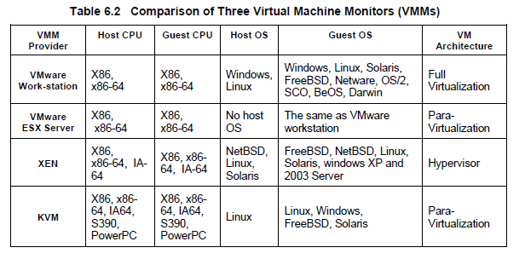
Major VMM and Hypervisor Providers

Slide 20
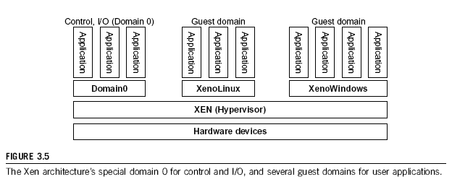
The XEN Architecture (1)

Slide 21
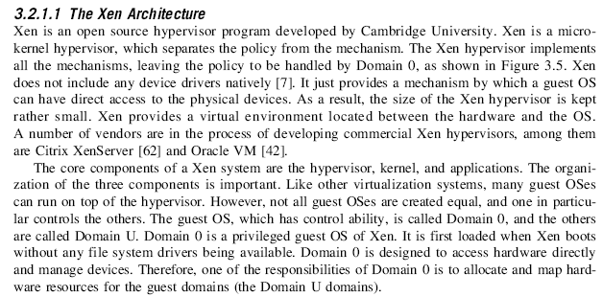
The XEN Architecture (2)

Slide 22
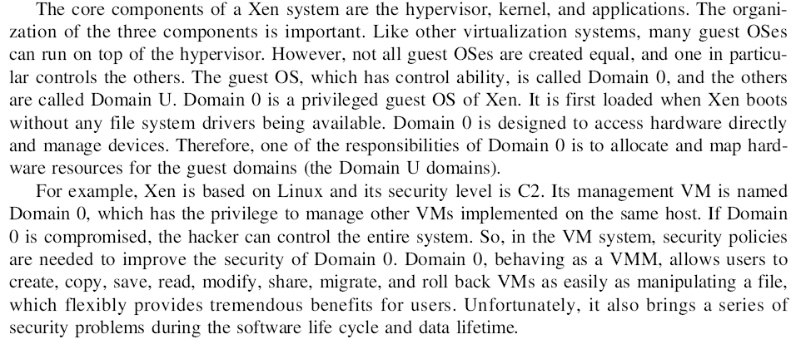
The XEN Architecture (3)

Slide 23
Full Virtualization vs. Para-Virtualization
Full virtualization
Does not need to modify guest OS, and critical instructions are emulated by software through the use of binary translation.
VMware Workstation applies full virtualization, which uses binary translation to automatically modify x86 software on-the-fly to replace critical instructions.
Advantage: no need to modify OS.
Disadvantage: binary translation slows down the performance.
Para virtualization
Reduces the overhead, but cost of maintaining a paravirtualized OS is high.
The improvement depends on the workload.
Para virtualization must modify guest OS, non-virtualizable instructions are replaced by hypercalls that communicate directly with the hypervisor or VMM.
Para virtualization is supported by Xen, Denali and VMware ESX.

Slide 24
Full Virtualization

Slide 25
Binary Translation of Guest OS Requests using a VMM:

Slide 26
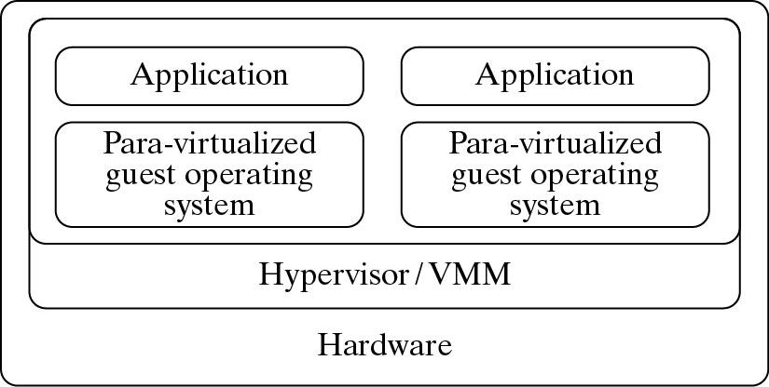
Para- Virtualization with Compiler Support.
The KVM builds offers kernel-based VM on the Linux platform, based on para-virtualization

Slide 28
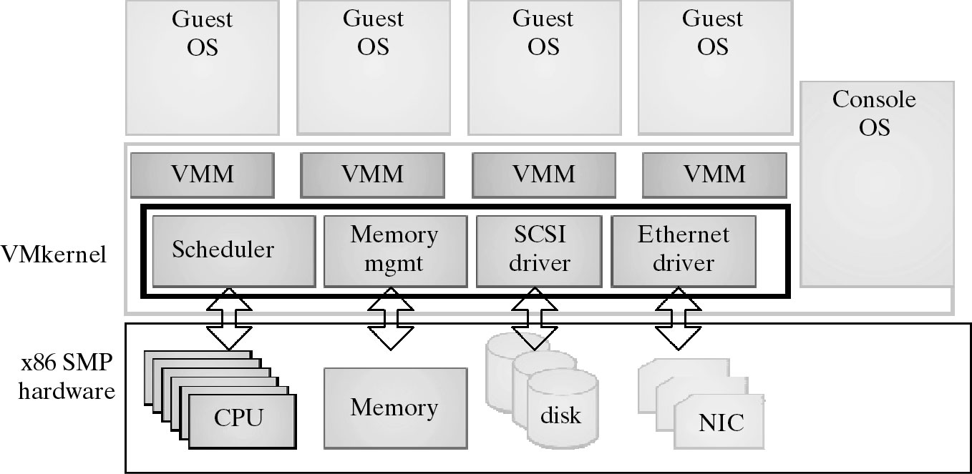
VMWare ESX Server for Para-Virtualization

